Slide 1
Side effects of Recombinant Tissue Plasminogen Activator (rtPA)
Fardin Faraji
Associate Professor of Neurology
Complementary and Traditional Medicine Research Center
Applied Neuroscience Research Center
Arak University of Medical Sciences

Slide 2
Intracerebral Hemorrhage (ICH)
IV-rtPA is the mainstay of treatment for acute ischemic stroke when administered within 4.5 hours of symptom onset.
The most feared complication is ICH, which has been associated with close to 50% mortality , have shown an incidence of 2-9% .
The AHA /ASA guidelines for care after thrombolysis include blood pressure control (<180/105 mm Hg after treatment) and avoiding the use of anticoagulant and antiplatelet agents in the first 24 hours of treatment.
The occurrence of ICH after IV- rtPA : coagulopathy , disruption of the BBB ( formation of oxygen free radicals, activation of metalloproteinases because of ischemia ) , Reperfusion after thrombolysis .

Slide 3
Clinical deterioration may not occur at the onset of thrombolysis-related ICH because the hemorrhage typically starts in infarcted brain tissue .
The new symptoms may be detected several hours later and are attributable to symptomatic mass effect or increased ICP .

Slide 4
rtPA Mechanism of Action
Intravenous rtPA produces local thrombolysis by converting plasminogen into plasmin, which in turn degrades fibrin into fibrin split products.
rtPA is short acting, with more than 50% cleared 5 min after cessation of the infusion and approximately 80% cleared after 10 min .
Clearance of rtPA is primarily through the liver, and it is excreted in the urine.
Prolongation of the PT and PTT as well as a reduction in fibrinogen levels, which may last 24 hours or more from the infusion time.
Among the coagulation profile components, the degree of reduction in fibrinogen may best correlate with the degree of thrombolysis and hemorrhage risk .
The occurrence of ICH appears to be higher when there is a reduction in fibrinogen by more than 200 mg/dL 6 hours after treatment .
rtPA dose of 0.9 mg/kg (maximum dose, 90 mg) is safe .

Slide 5
The recommended management in the AHA/ASA acute treatment guidelines includes replacement of coagulation factors and platelets .
The paucity of data on how to treat ICH has led to substantial variability in the treatment algorithm used .
approximately 40% of the patients with ICH had continued bleeding .
Immediate surgical treatment is usually avoided in ICH because of the high perioperative risk associated with intravenous rtPA-related coagulopathy .
The lack of consensus on how to manage ICH as well as continued poor outcomes pose important challenges in clinical research on acute stroke .

Slide 6
Proposed treatments to prevent hematoma expansion and neurologic worsening in symptomatic ICH include :
vitamin K
FFP
Cryoprecipitate
prothrombin complex concentrates ( PCC )
platelet transfusions
ε-aminocaproic acid
Recombinant VIIa factor

Slide 7
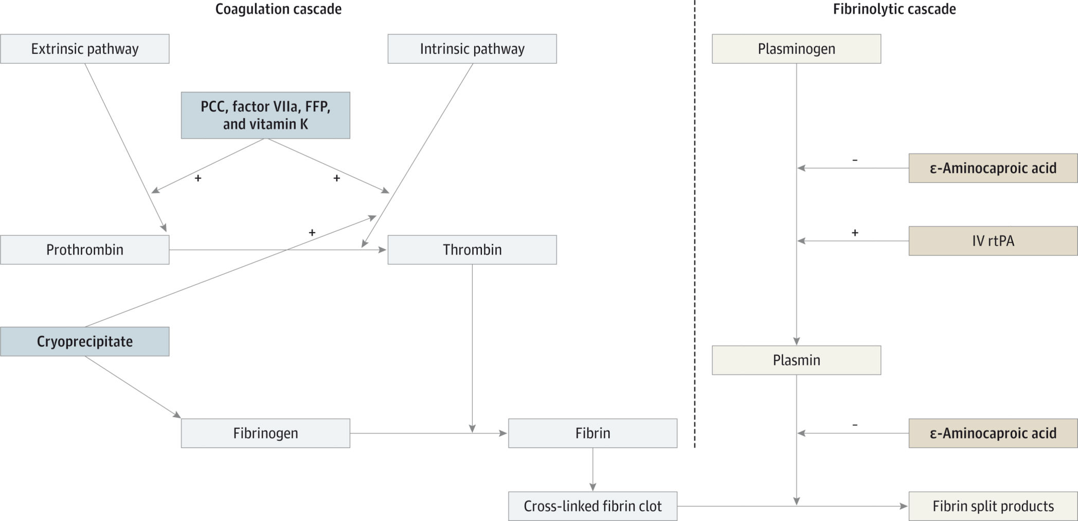
Coagulation and Fibrinolytic Pathways Showing the Mode of Action of Symptomatic ICH Treatment

Slide 8


Slide 9
Fresh Frozen Plasma ( FFP )
FFP refers to the plasma collected from blood donors and frozen at −18°C .
FFP has to be administered slowly in large intravenous volumes to prevent volume overload and other transfusion-related reactions which increases the time for this treatment .
FFP takes a median of 30 hours to return the INR to within the reference range .

Slide 10
Vitamin K
Vitamin K promotes liver synthesis of factors II, VII, IX, and X, as well as the endogenous anticoagulants proteins C and S .
vitamin K treatment is relatively safe .
it takes several hours for the liver to synthesize those factors .
Vitamin K, given at a dose of 10 mg IV, can reverse coagulopathy in patients with warfarin-related ICH within 12 to 24 hours, with minimal risk of an anaphylactic reaction (1 of 3000 patients).
vitamin K may not be the ideal monotherapy .
However, use of vitamin K could potentiate other treatments because it may activate both the extrinsic and intrinsic coagulation pathways .

Slide 11
Prothrombin Complex Concentrates (PCC)
A combination of the vitamin K–dependent factors II, VII, IX, and X along with proteins C and S ( both the intrinsic and extrinsic coagulation pathways ) .
Correct the INR in less than 30 minutes after an infusion without requiring large intravenous volumes .
Do not require the administration of large volumes of intravenous fluids.
A relatively quick way to activate both the intrinsic and extrinsic pathways .
The low risk (approximately 1%) of thrombotic events .

Slide 12
ε-Aminocaproic Acid
ε-Aminocaproic acid inhibits fibrinolysis by preventing the conversion of plasminogen to plasmin, as well as directly inhibiting the proteolytic activity of plasmin, resulting in clot stabilization.
a relatively short half-life (2 hours) .
its peak action approximately 3 hours after administration .

Slide 13
Recombinant Factor VIIa
Recombinant factor VIIa is a vitamin K–dependent glycoprotein that promotes homeostasis by activating the extrinsic coagulation cascade .
a short half-life(2.3 hours) and a meantime of 6 hours to reverse the INR in warfarin-related coagulopathy ( fast action ).
In patients with ICH, recombinant factor VIIa is not routinely recommended because of a lack of clinical benefit and increased risk for thrombotic events.

Slide 14
Cryoprecipitate
Cryoprecipitate is prepared from FFP thawed at approximately 4°C and consists of fibrinogen (approximately 200 mg per unit of cryoprecipitate), factor VIII (approximately 100 U per unit of cryoprecipitate), and von Willebrand factor.
Cryoprecipitate has a fast onset of action and quickly increases fibrinogen levels.
Because it also contains factor VIII, cryoprecipitate activates the intrinsic pathway .
Typical doses of cryoprecipitate (8–12 U)increase fibrinogen levels by only approximately 50 to 70 mg/dl.
a decrease in fibrinogen levels of greater than 200 mg/dL is a risk factor for ICH. It is thus likely that 10 U of cryoprecipitate may not be sufficient to replenish the reduction of fibrinogen caused by rtPA when a ICH occurs .

Slide 15
Platelet Transfusion
Plasmin initially activates platelets, an effect mediated by an increase in local calcium concentrations, followed later by platelet inhibition mediated by ADP as well as decreased expression of platelet glycoprotein Ib .
The AHA / ASA guidelines recommend using platelet transfusions in the treatment of ICH; however, the role of platelet dysfunction in the mechanism of ICH formation is not well known.

Slide 16


Slide 17
Surgical Treatment
Clot evacuation in ICH can be considered in patients with lobar hemorrhage within 1 cm from the surface
Surgeons may be reluctant to perform a craniotomy in the acute setting while the patient is coagulopathic
Less is known about surgical options after coagulopathy has resolved, including the potential benefit of hemicraniectomy

Slide 18
Conclusion
Although there are no established treatments for reversing coagulopathy in patients with ICH, the AHA/ ASA guidelines recommend replacement of coagulation factors and platelets using 10 U of cryoprecipitate and 6 to 8 U of platelets
Because the coagulopathy related to rtPA may last up to 24 hours , early and sustained reversal is necessary before hematoma expansion and neurologic deterioration occurs.
Aggressive approaches must be weighed against the potential for worsening thrombosis.
agents with a fast onset of action, such as PCCs, recombinant factor VIIa, and ε-aminocaproic acid.

Slide 19
Angioedema after Thrombolysis
occurring in 1.3–5.1% of patients .
Patients with concomitant ACE inhibitor use are at an increased risk of angioedema following rtPA .
There are three major causes of angioedema:
mast cell mediated (allergic reactions , NSAIDs )
bradykinin mediated (ACE inhibitors , C1 inhibitor deficiency)
unknown mechanisms (idiopathic angioedema, fibrinolytic)
ACE inhibitors are the leading cause of drug-induced angioedema in the USA with 0.1–0.7% of patients taking the drug developing angioedema

Slide 20
Angioedema
Most cases of post-rtPA angioedema begin within an hour of completion of rtPA infusion and hemilingually, usually contralateral to the area of infarct which may due to autonomic dysfunction
The main risk factors for developing angioedema ofter rtPA administration include ACE-inhibitor use (relative risk 13.6) and early signs of infarction in the MCA territory (relative risk 6.4)
most cases of rtPA associated angioedema are mild and self-limiting

Slide 21
Angioedema
Angioedema following rtPA infusion is thought to be bradykinin
Mediated
rtPA generates plasmin, which cleaves kininogen into bradykinin. Bradykinin is a vasodilator and increases vascular permeability, allowing fluid to move into interstitial tissues
When angioedema is caused by bradykinin, treatment with antihistamines, corticosteroids and epinephrine is generally ineffective and is not recommended . However, initial and maintenance doses of these medications are often administered
Many cases will resolve with only supportive care

Slide 22
Treatment
FFP
Icatibant (a bradykinin B2 receptor antagonist)
Ecallantide (a recombinant protein that inhibits Kallikrein) have been used in ACE-inhibitor induced angioedema and may be helpful in rtPA associated angioedema given that both processes are bradykinin mediated
Because administration of rtPA activates the complement cascade, C1-esterase inhibitor may improve angioedema associated with rtPA administration and allow avoidance of airway maneuvers
intubation

Slide 23


